Slide 1
Mid-Sprint Review 8
The Brewing Game
6th March 2026
Gracjan Blazejowski
Bruce Gray
Marta Grazia
Sergio Eneide
Aaron Stevens

Slide 2
Sprint work
CI/CD workflows for automatic build distribution,
Finished the in-game Shop,
Automated testing workflows,
Additional instruments underway
Gracjan B

Slide 3
Finished Shop
Redesigned the UI element,
Refactored Instruments to be available for purchase outside of the mash tuns,
Fixed scaling issues,
Applied purchased upgrades to mash tuns
Gracjan B

Slide 4
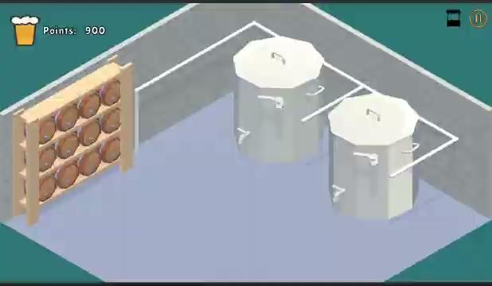
Finished Shop
Gracjan B

Slide 5
CI/CD workflow
Made precursory research to evaluate the feasibility of automated builds,
Created a working .yaml prototype for the rest of the team to take over,
Created a docker container with Unity package pre-installed to minimize the amount of time per build
Gracjan B

Slide 6
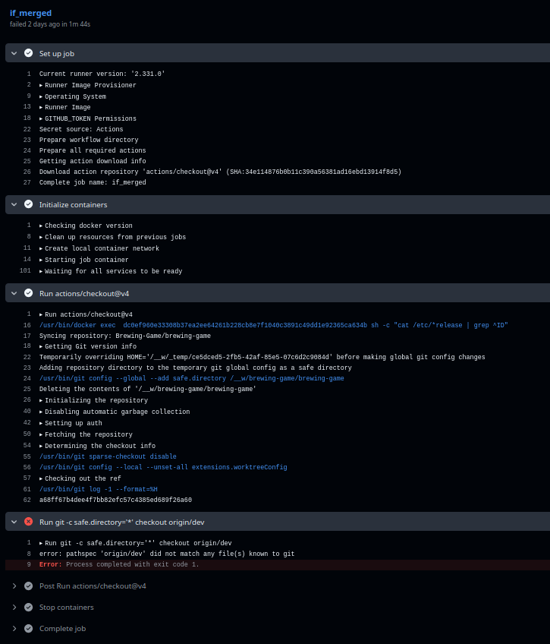
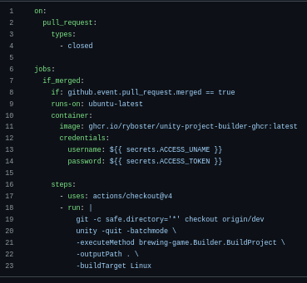
Gracjan B

Slide 7
Marta’s progress
🤌🤌 (they’re doing well),
Found & fixed the color bug in the UI,
Researched further instrument additions and compiled their findings into a document,
Refactored existing instruments to better reflect the new item names,
Started work on updating our UML design
Gracjan B

Slide 8
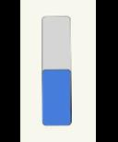
Color bug
Upon finalizing the Shop, the color of the indicator when brewing beers stopped changing due to having refactored the Instrument class
Gracjan B

Slide 9
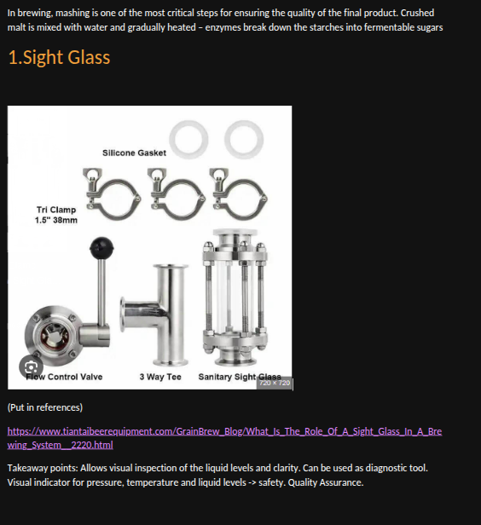
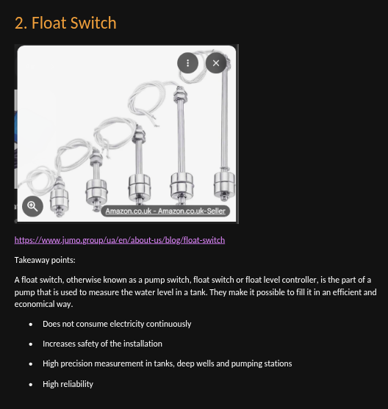
Instrumentation Research
(...)
Gracjan B

Slide 10
Renamed Instruments
AutoStopValve -> FloatSwitch
WaterLevelGauge -> SightGlass
Gracjan B

Slide 11
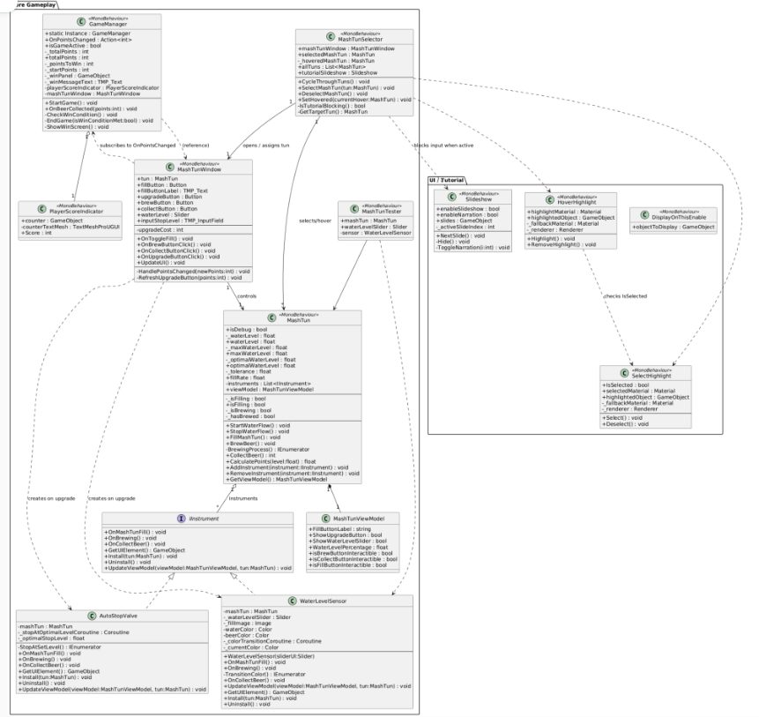
Big UML
Gracjan B

Slide 12
Automated Testing
Using EditMode tests for core game logic without UI
Can run automatically on pull request
Serialized fields require a workaround for testing
Bruce G

Slide 13
Thank you!
The Brewing Game’s Team

